Slide 1
NATO/Norge og Russland med fokus på Nordområdene 14. september 2017
Flaggkommandør Hans Chr. Helseth NOR NA
Special Advisor to Commander
Joint Warfare Centre, Stavanger

Slide 2
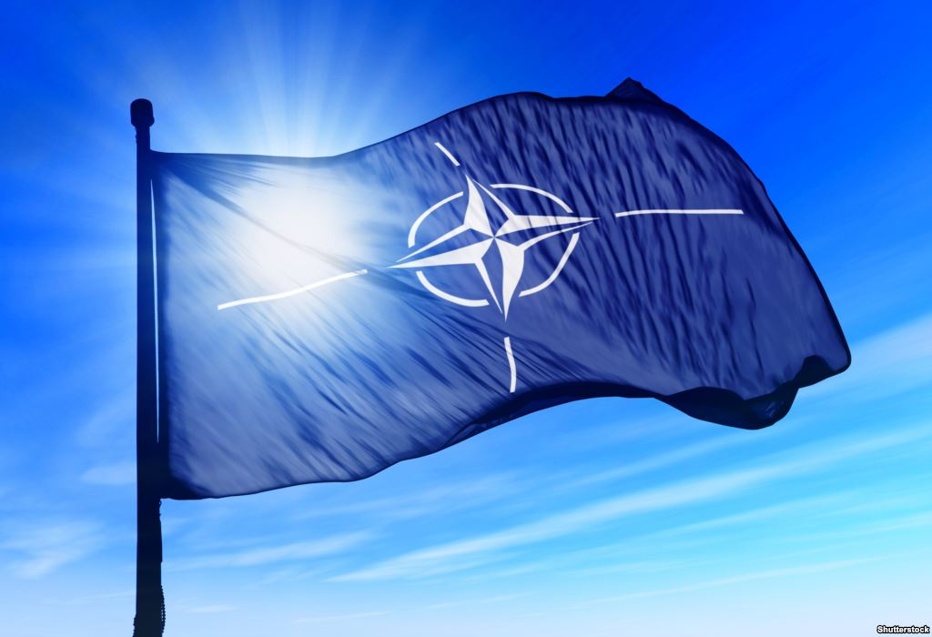
Agenda
NATO of today
Norway’s strategic situation – a truly maritime nation
Russia - the Big Picture
NATO’s responses
Questions and Comments

Slide 3
NATO Treaty Article 5
The Parties agree that an armed attack against one or more of them in Europe or North America shall be considered an attack against them all and consequently […], each of them, in exercise of the right of individual or collective self-defence recognized by Article 51 of the Charter of the United Nations, will assist the Party or Parties so attacked by taking forthwith, […], such action as it deems necessary, including the use of armed force, to restore and maintain the security of the North Atlantic area.

Slide 4
NATO in a Nutshell
29 democratic and independent sovereign nations
22 nations members of both EU and NATO
Most successful Alliance in history
Purpose is to defend common values and individual integrity
Political as well as military organization
Have faced and is facing a variety of challenges

Slide 5
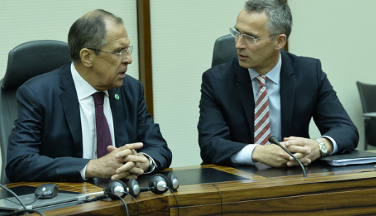
NATO is changing
East: Russia is considered a threat
I just met with Foreign Minister Lavrov and […] I re-stated the very strong NATO position on the illegal annexation of Crimea ….
Southeast: ISIL/Daesh
South: Uncontrolled migration
360°: Farther afield ….

Slide 6
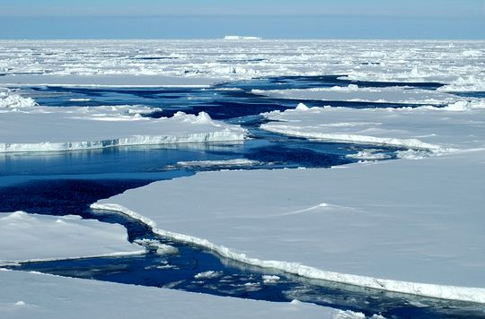
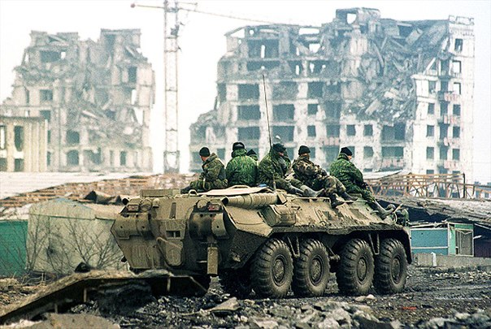
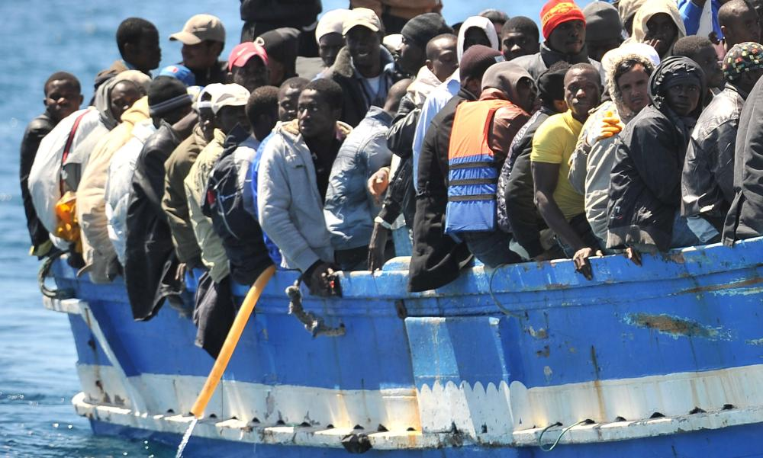
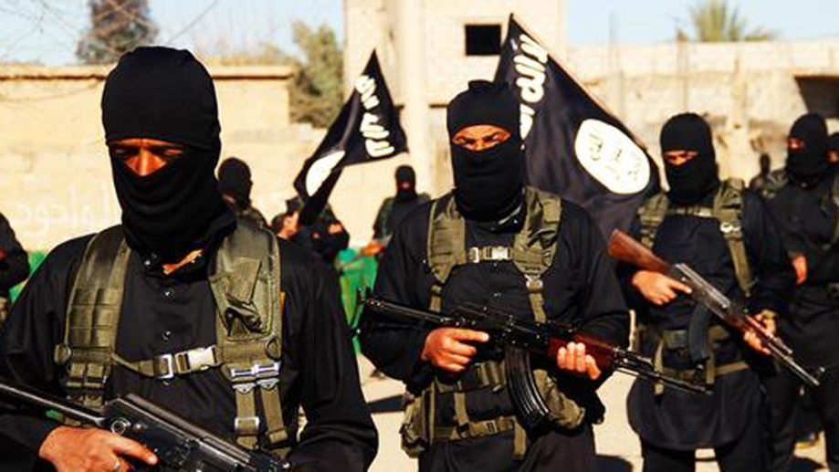
NATO and the high North
Room for one more?

Slide 7
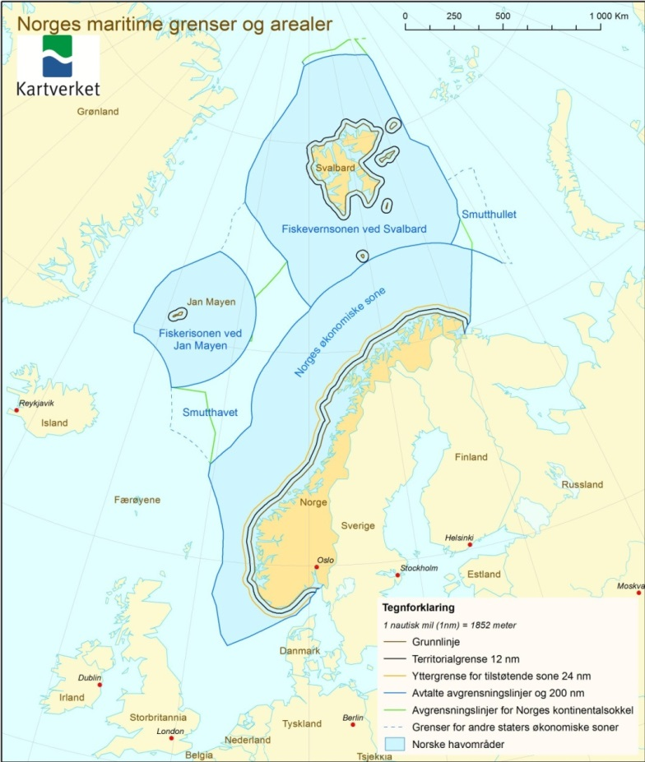
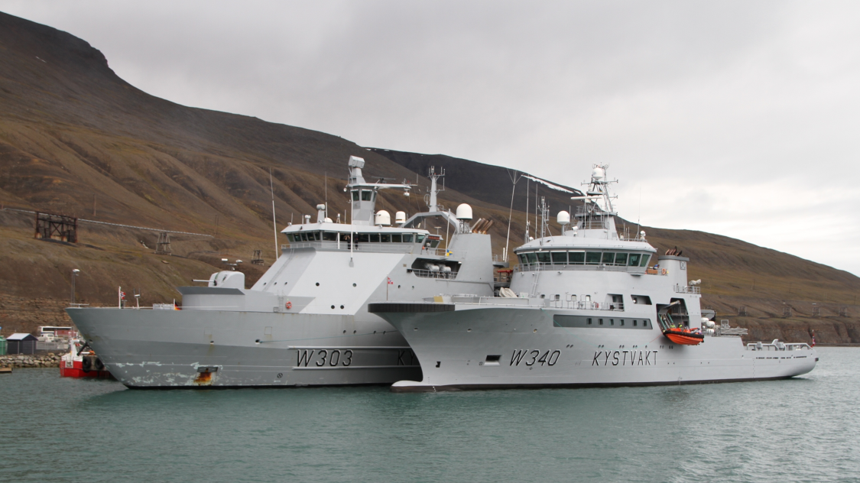
Norway – Six times more water than land

Slide 8
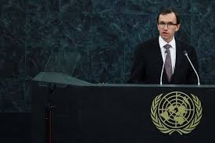
A Maritime Nation ...
“Praktisk talt alt vi lever av i dette landet er enten under havet, i havet eller oppå havet – olje/gass, fisk/sjømat og shipping og maritime tjenester.”
Espen Barth Eide: Hva er Norges utenrikspolitiske interesser? Det Akademiske Kvarter, Bergen 13. mars 2013 .
Norway’s periphery is its economic centre – and hence vunerable

Slide 9
A central periphery ?
Economically, the periphery is the key area
... but vulnerable !
The ocean is a highway and not a defensive feature
More than 40 % of export value originates from West Norway

Slide 10
27th April 2010 – The signing of the Barents agreement

Slide 11
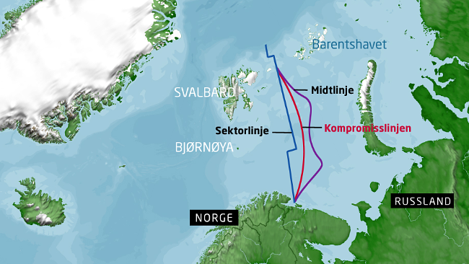
After about 40 years…..

Slide 12
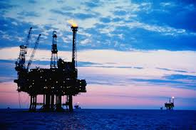
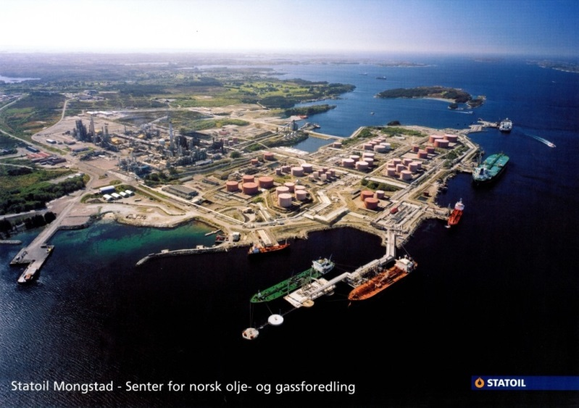
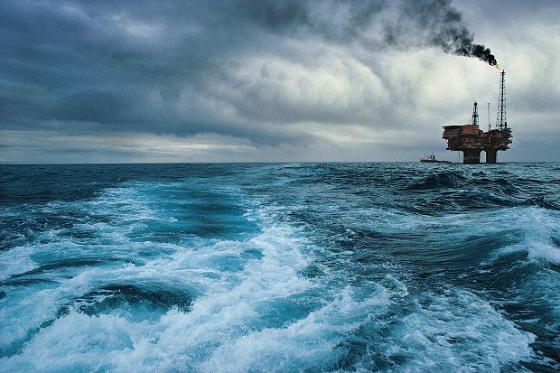
Oil and Gas
Oil declining, still 10th largest exporter in the world
Natural gas to Europe (28% of EU imports and growing)

Slide 13
More gas exported - every year

Slide 14
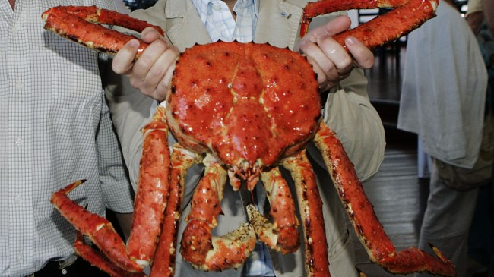
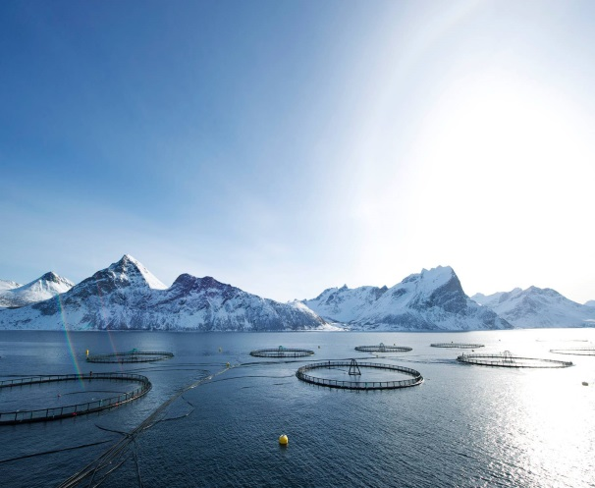
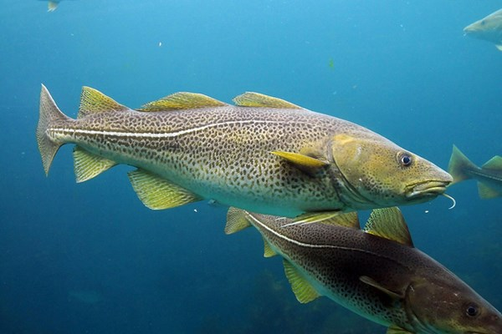
Fisheries
Second largest exporter (10% of world total)
Fish farming, shellfish
Good management of wild fish stocks
Yum – Yum !

Slide 15
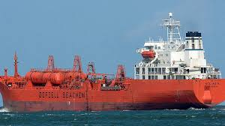
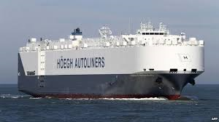
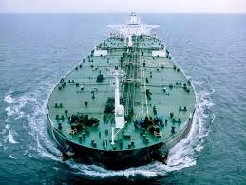
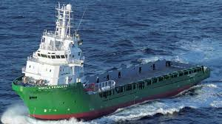
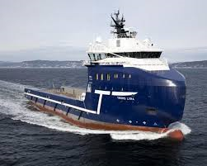
Merchant Navy
Under NOR flag 21 mio ton, 14th largest
Under NOR control, 7th largest nation

Slide 16
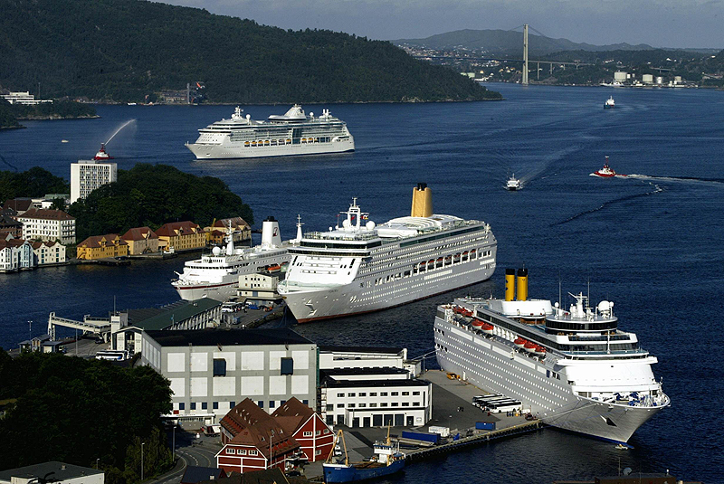
Maritime Services
Maritime Cluster (world leader)
Shipyards, construction
Financing, brokering
Classification, quality control
Schools, crews
95% of all trade
Tourism (25 mio days)
Bergen Harbor – about tea time

Slide 17
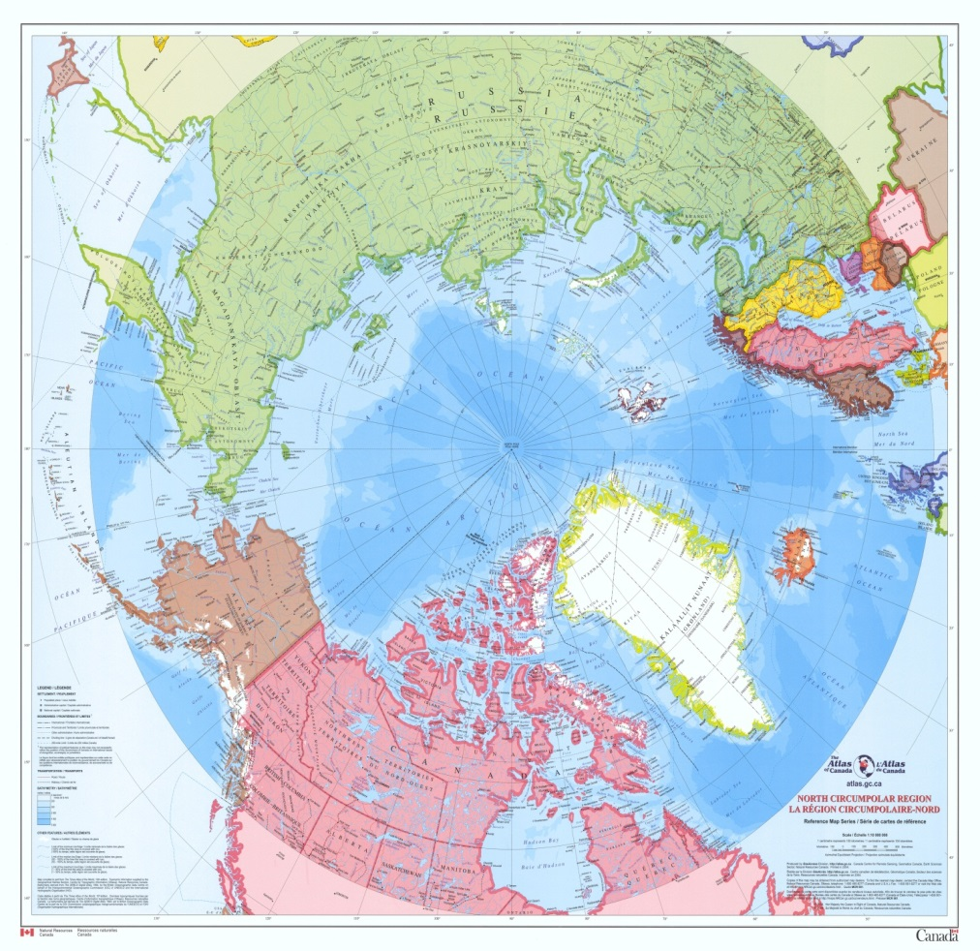
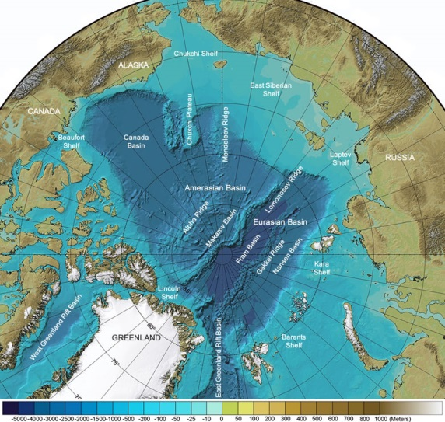
High North

Slide 18
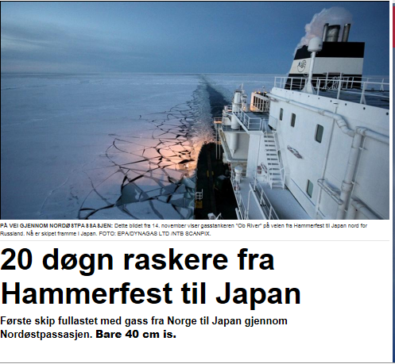

Slide 19
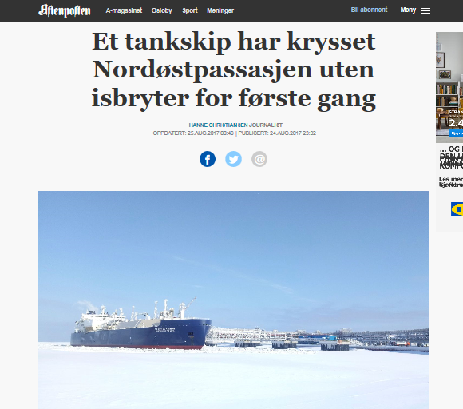

Slide 20
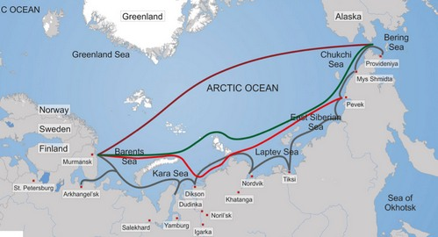
Northeast Passage
International Strait (?)
Reduces the passage between Europe and far East about 50%
Open a couple of months per year to specialized vessels accompanied by icebreakers
Numbers of crossings/year

Slide 21
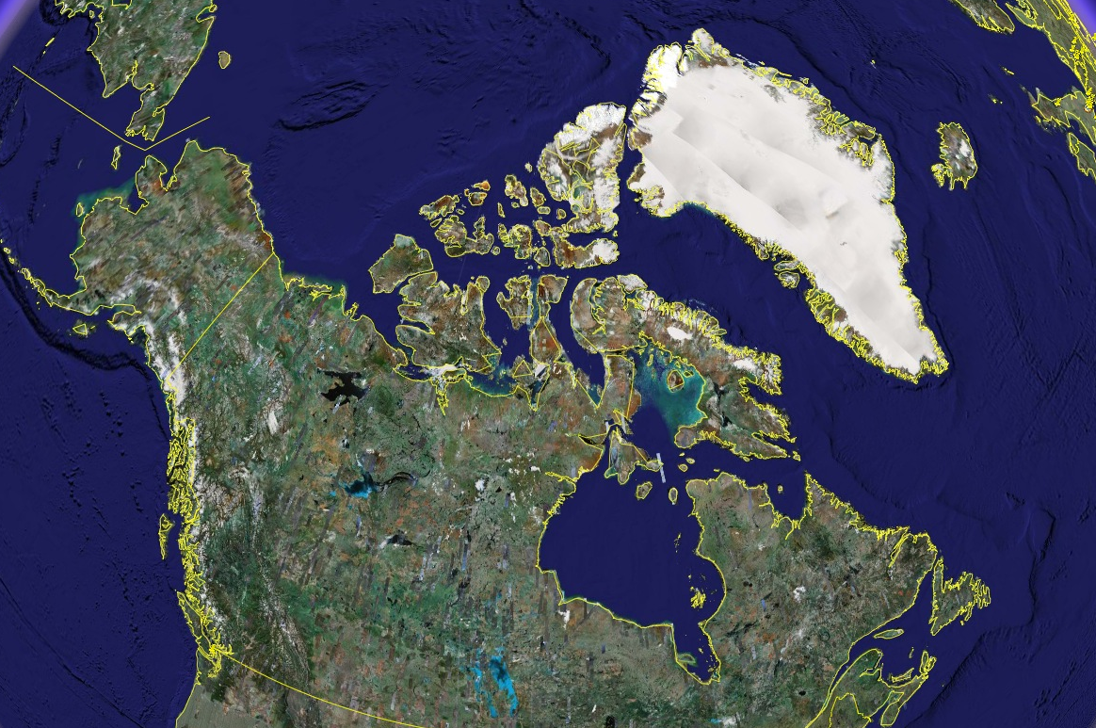
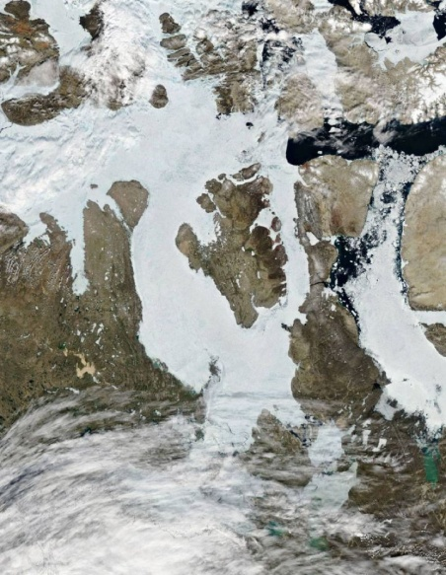
Northwest Passage? Not ...
Northwest
Passage

Slide 22
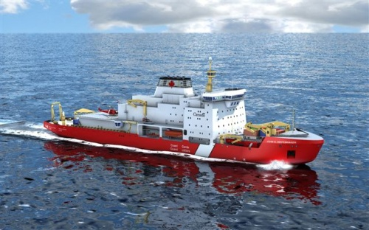
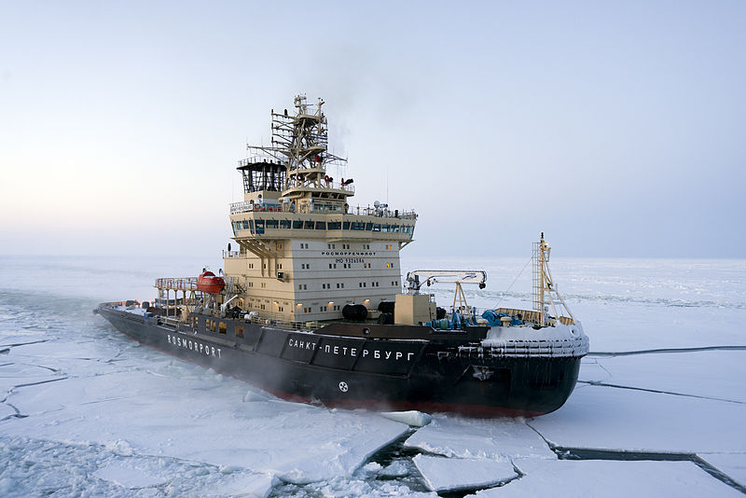
Other arctic factors
ICE Breakers (civ/mil) (all waters & purposes):
CDN 8, DNK 3, NOR 1, USA 3, RUS 40
Effect of the Gulf Stream
Mapping, Navigational aids
Environment
Civilian research
Historical interest, political will

Slide 23
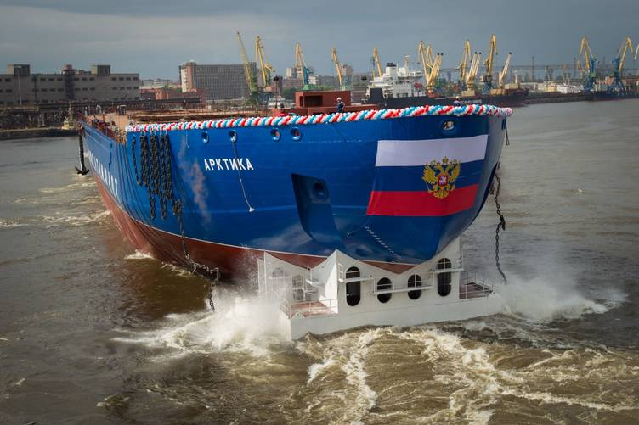
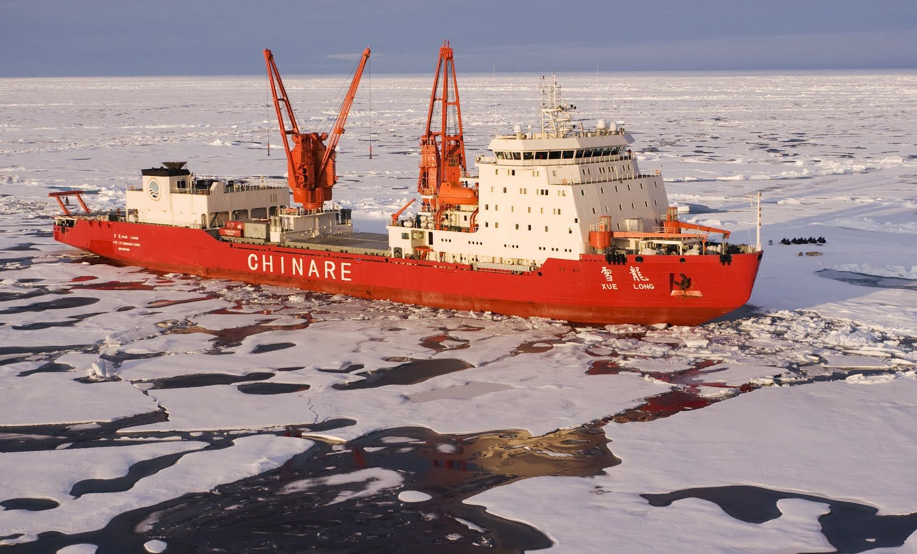
Arktika - 2016
Xue Long

Slide 24
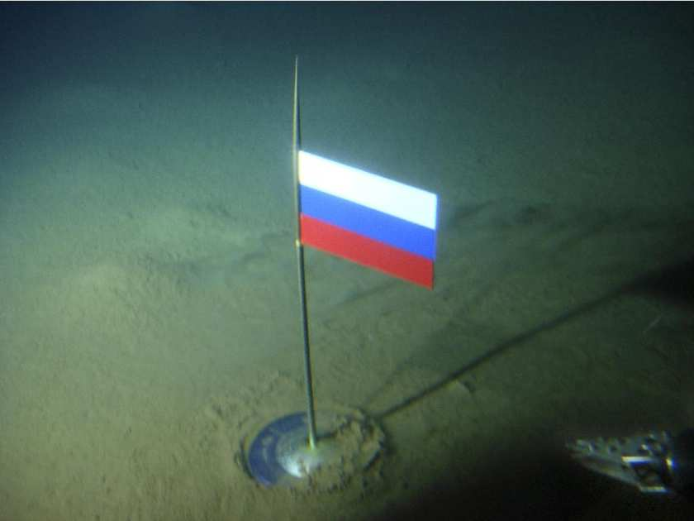
UNCLOS
UN Convention of the Law of the Sea is respected by all parties (however, not ratified by USA)
350 nm continuation of continental shelf
Might is right ?
Russia has a strong claim, supported by detailed research

Slide 26
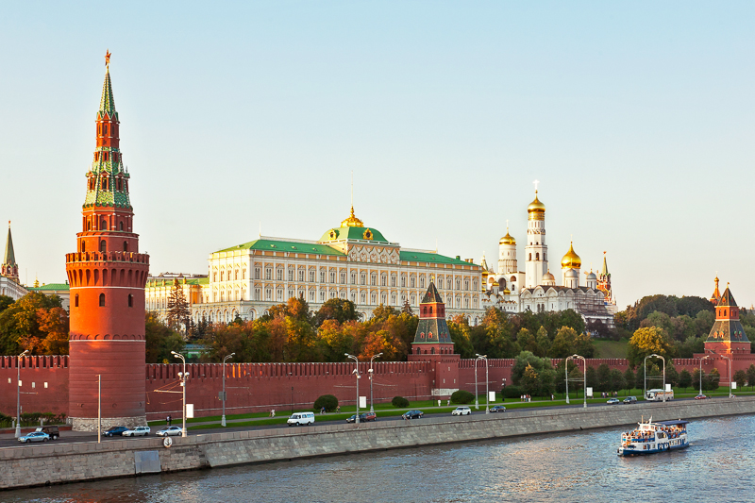
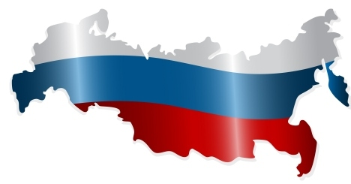
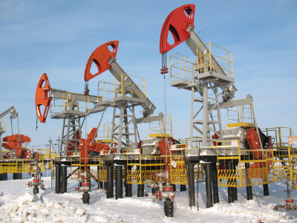
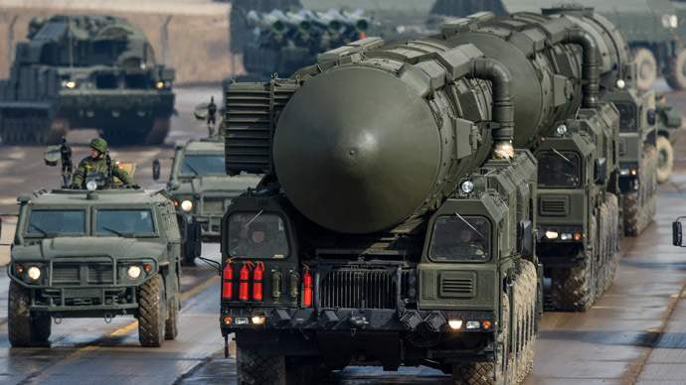
Russia: The Big Picture

Slide 27
Russia - The Big Picture
Russia is not a free and democratic country
No independent press, no political opposition tolerated, a parliament without power, Putin omnipotent
Fear of unrest and colored revolutions
Serious economic challenges, no allies, sanctions continue
Russia seeks to regain the international role of the USSR and use military force to obtain it
West perceived as carving away on Russia’s ‘area of influence’
NATO was deliberately defined as a threat to justify Putin’s ambitions

Slide 28
Russian Military Capabilities
Nuclear Triad
Proved ability to deploy large land forces quickly at strategic distances
Air Defence
Short chain of command
Proven willingness to use military means to achieve political goals
Completely outdated Navy, except submarines
Outdated Air Force, with exceptions
Reserves obsolete
No Allies of value
Politically isolated, weak economy

Slide 29
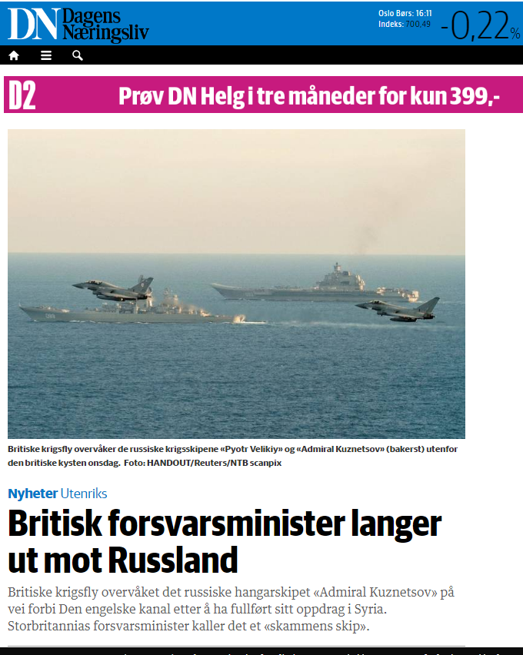
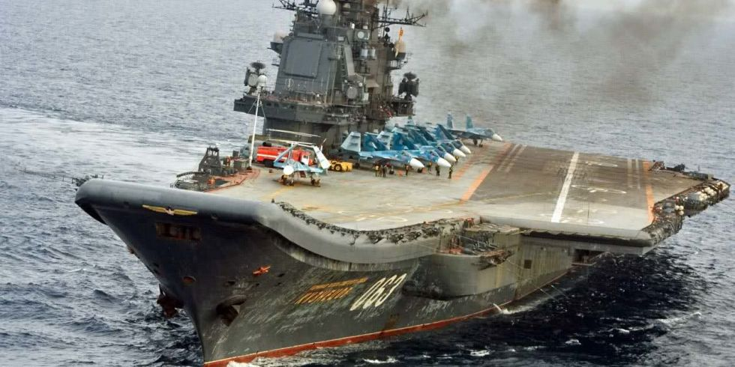
KTG
2 A/C lost
No Carrier ops – from land
Appalling technical standards
Lack of trained aircrew
Probably last deployment
Moral aspects of joining a conflict to test weapons and systems on a suffering population ….

Slide 30
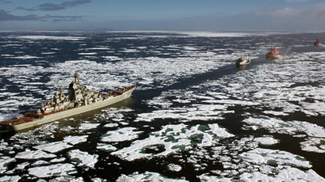
Militarization of the Arctic
No USA, CDN, DNK bases north of Arctic Circle
Limited mil presence (ICEX, patrols, BMD ISR)
Coast Guard patrols (DNK, NOR)
Russia building 6+ bases A2AD capable (S-400, Bastion SSM, ISR, BMD warning), Arctic COM

Slide 31
NATO – Russian Relations
Post CW | 2000 - 2001 | 2002 - 2003 | 2004 - 2005 | 2006 - 2007 | 2008 - 2009 | 2010 - 2011 | 2012 - 2013 | 2014 - 2015 | 2016 - 2018 | 2018 -2024?
.
Putin 1P
Putin 2P
Putin PM
Putin 3P (6 yrs)
ISAF, Piracy
Crimea
Ukraine
Libya
Kosovo
Syria
Georgia

Slide 32
East: NATO Responses
NATO Force Integration Units (NFIU)
Very high readiness Joint Task Force (VJTF)
Expanded NATO Response Force (eNRF)
Forward Presence in the Baltic states - Atlantic Response
Graduated Response Plans
Reawakening, Political unity, increased budgets in NATO
2 %

Slide 33
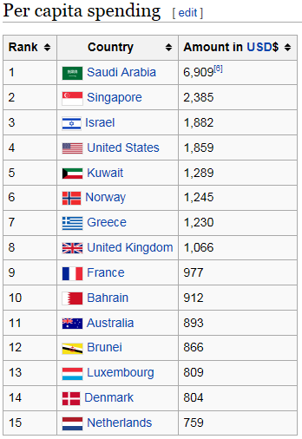
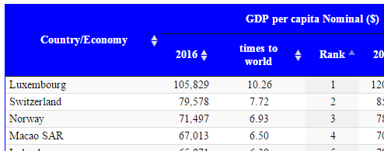
NOR Defense key factors
Budget 5,06 mia € (+9,8 %)
Balanced Navy
F-35 (54)
Small army, conscripts
Underfinanced, 1,4 % GDP
NATO strongly supported
2 %

Slide 34
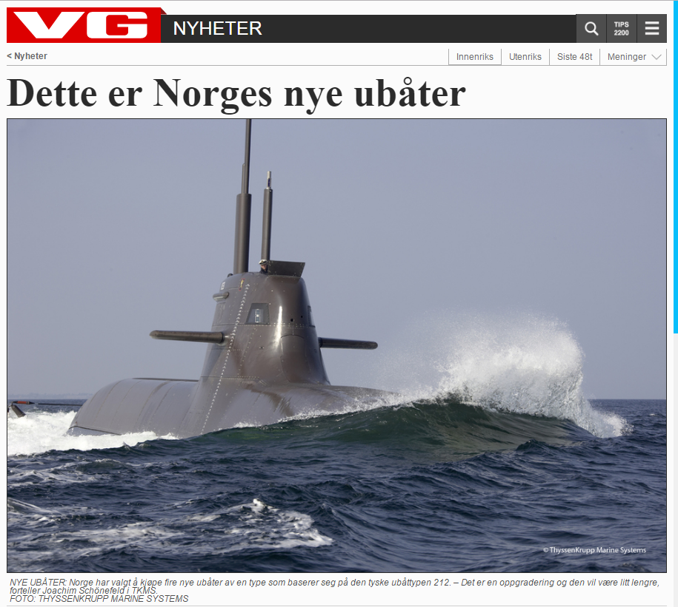
212 - Submarines
3 FEB 2017:
Thyssen-Krupp
4 Hulls 212 mod
3,5 BN €

Slide 35
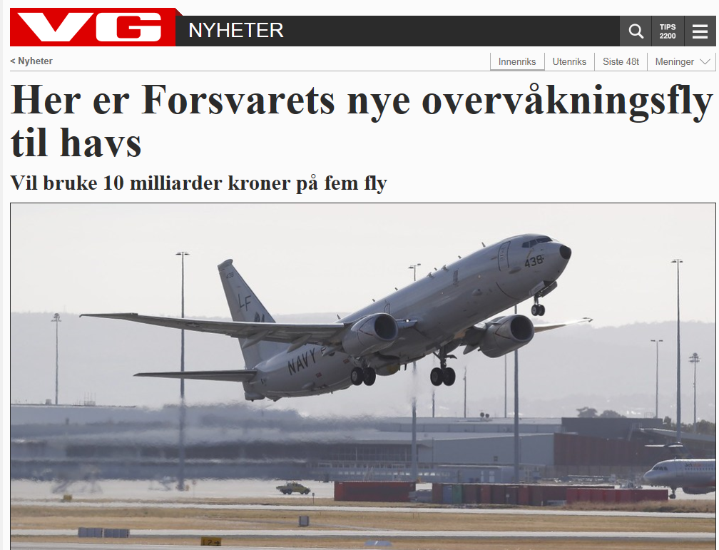
P-8 Poseidon
25 NOV 2016:
Boeing
5 flymaskiner
1 BN €

Slide 36
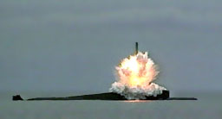
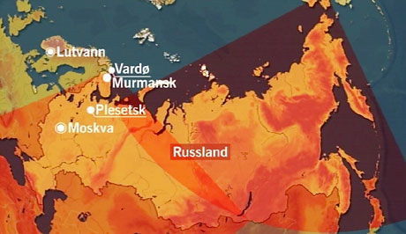
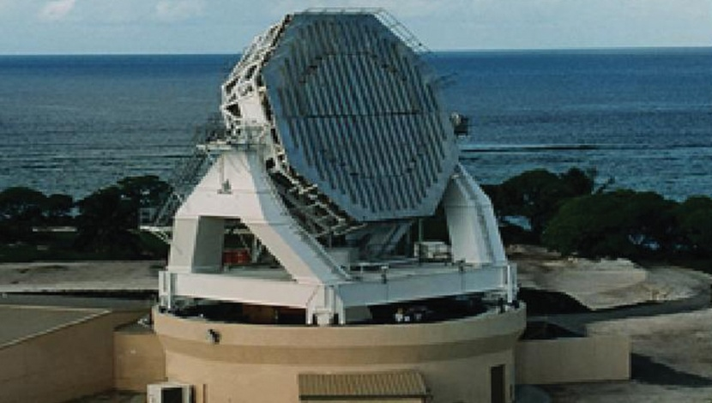
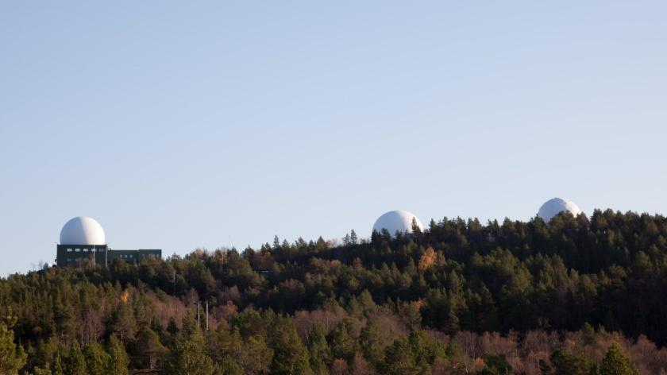
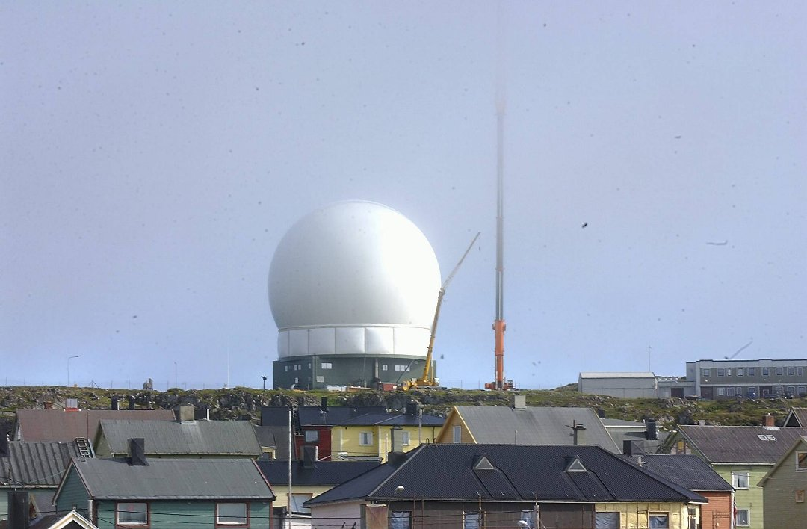
Intelligence

Slide 37
Spørsmål – før foring og vanning ….

